Slide 1
Research Diary
Keeping track of your ideas, interests and feelings in the process of a PhD

Slide 2
Things I have learnt from one year in a PhD
There is too much to read
There is so little time
There are so many things apart from research that take up my time
It is hard to remember what I was thinking last week, as my head is so full of new ideas

Slide 3

Fail to Prepare
Prepare to Fail?

Slide 4

An Extended Mind
The extended mind is an idea in the field of philosophy of mind which holds that the reach of the mind need not end at the boundaries of skin and skull. Tools, instrument and other environmental props can under certain conditions also count as proper parts of our minds.

Slide 5
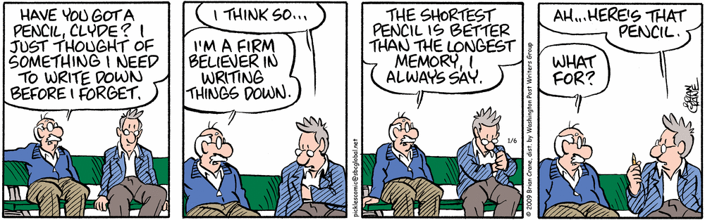

Slide 6
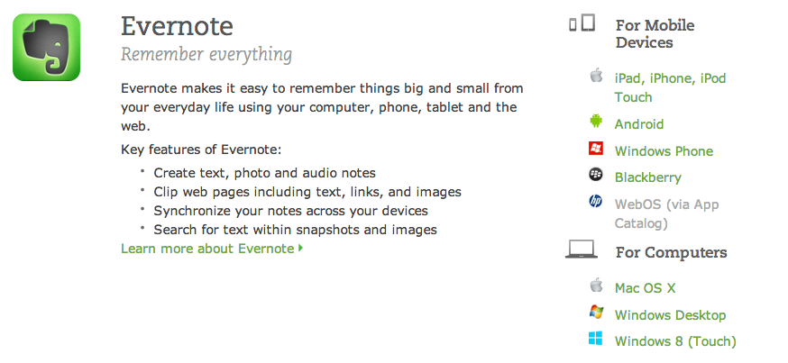
Evernote is my favourite pencil…

Slide 7
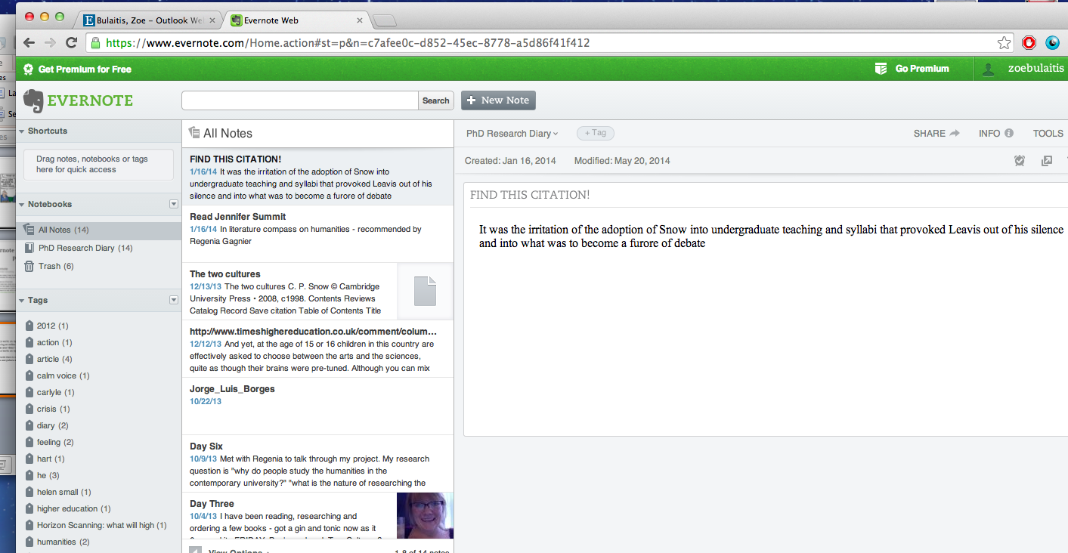
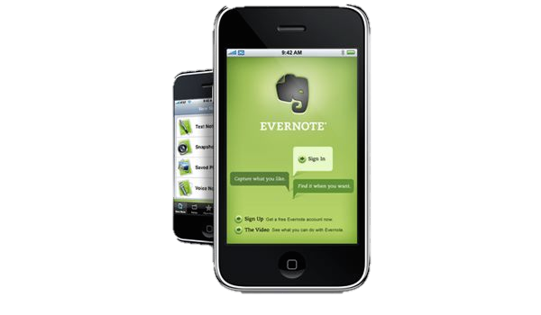
Stay Connected
Evernote works on my laptop
You can log on online and so use any computer anywhere to access your ideas / add some new ones
Evernote works on my smartphone
It syncs everything from one place to the other so everything is in one place.
There is no excuse not to note an idea down!

Slide 8
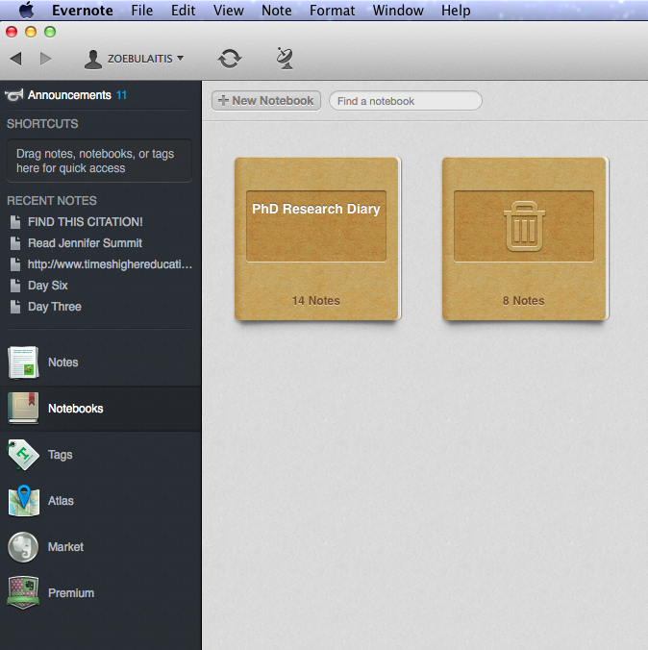
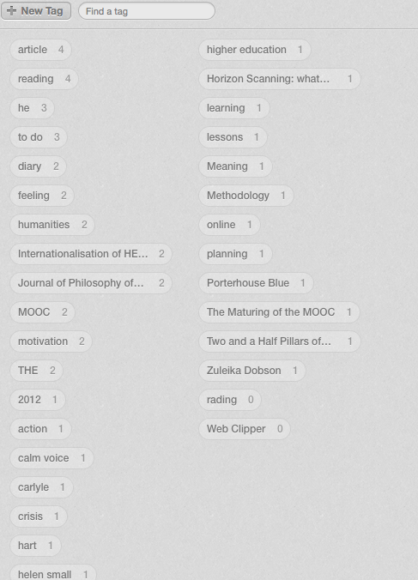
Get Organised
Keep more than one Diary Use tags to sort and
for different projects make your files super searchable!

Slide 9
Feel Good
In a process as long and complicated as a PhD you can feel lost / overwhelmed.
In keeping a diary you are able to see the slow movement of progress, and you are never stuck with what you could read / what ideas you could follow up.
Taking the pressure of a white Word document – writing in Evernote is informal and easy to do
Evernote makes research easier as you can even search text in images
(meaning that snapshots off Google books that you took a year ago are actually searchable! Is that just me?!)

Slide 10


